Slide 1
Garage Sale #1
Pick up at ZRC or main campus
Contact 929-372-4282 if interested

Slide 2

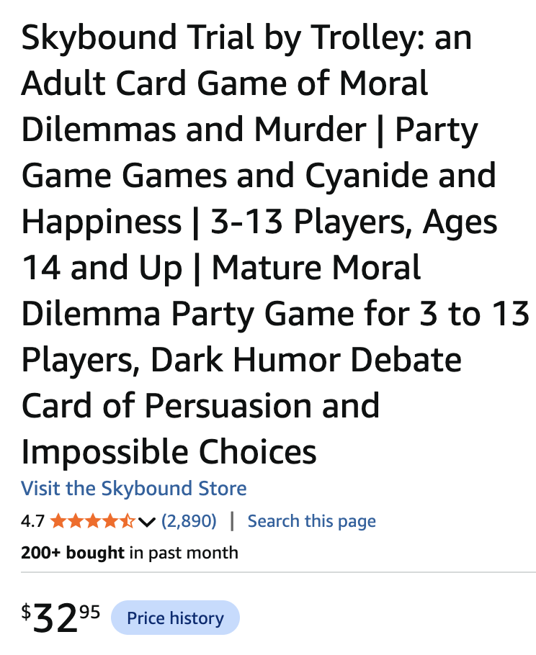
SALE Price $15

Slide 3


SALE Price $5

Slide 4

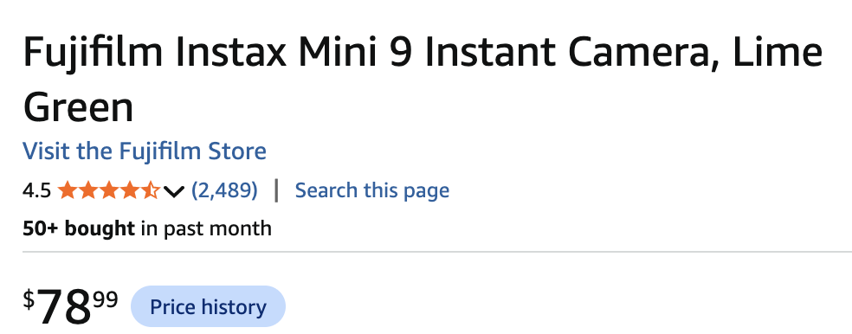
SALE Price $50
(includes the cover and some accessories

Slide 5

SALE Price $10
10 pcs

Slide 6
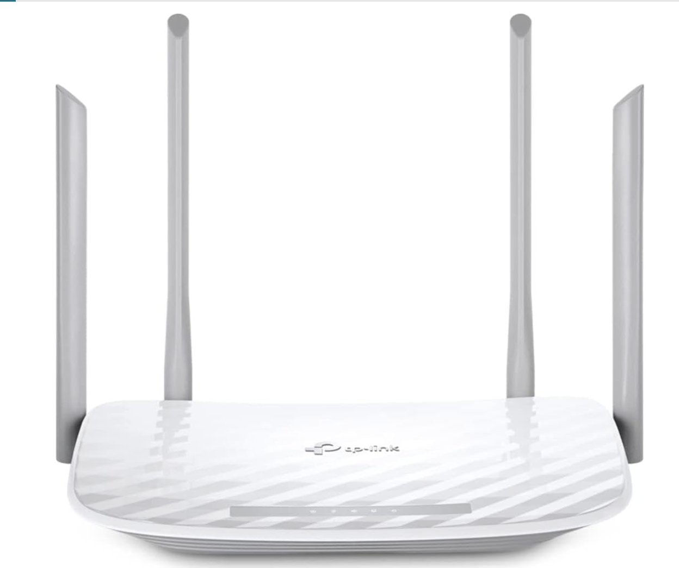
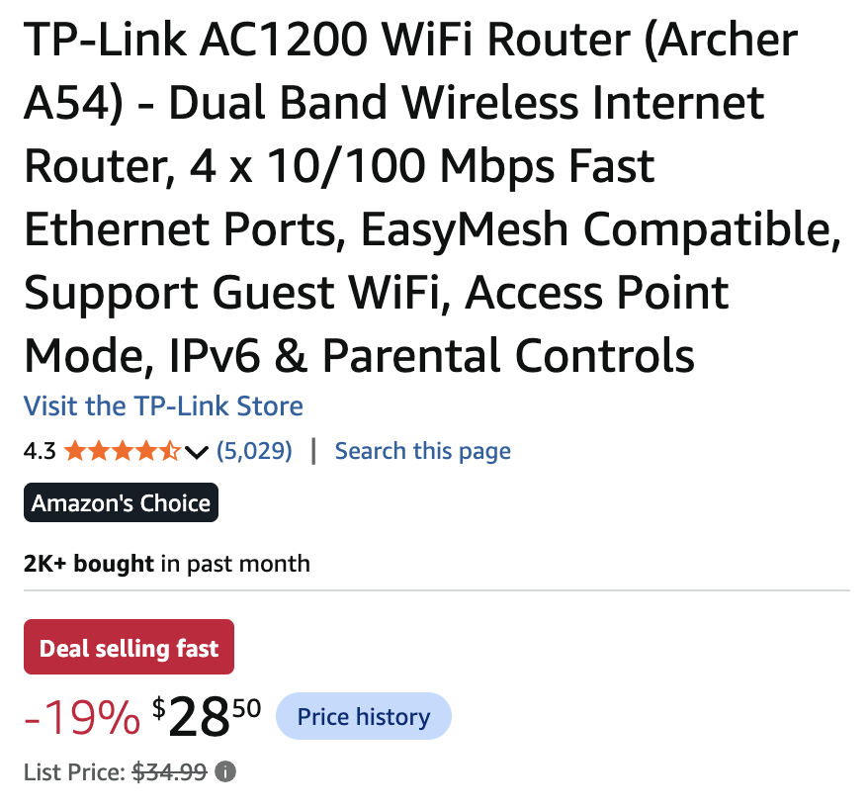
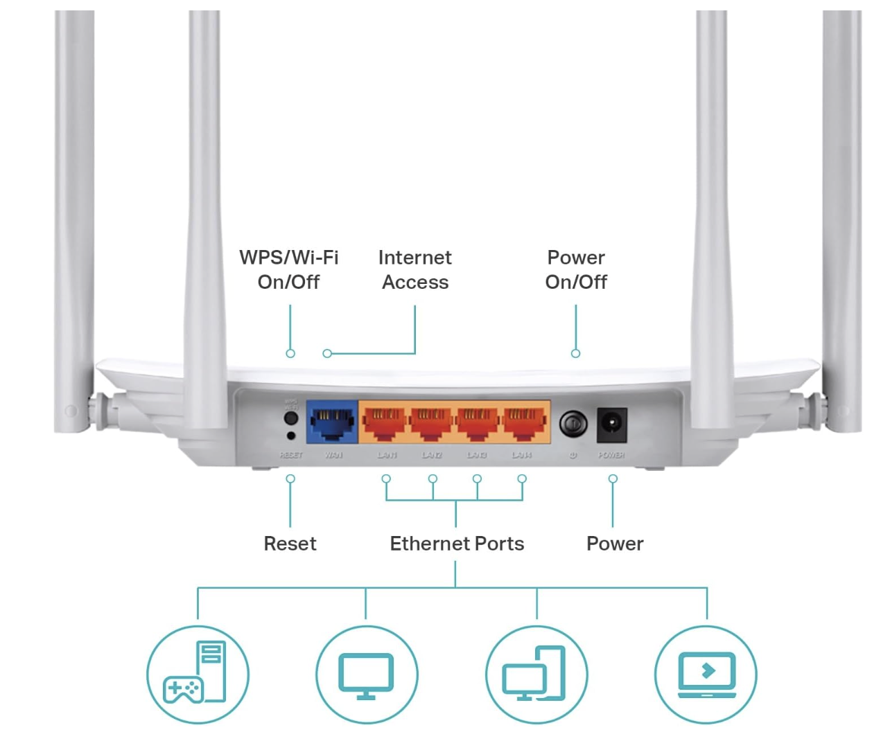
SALE Price $10

Slide 7
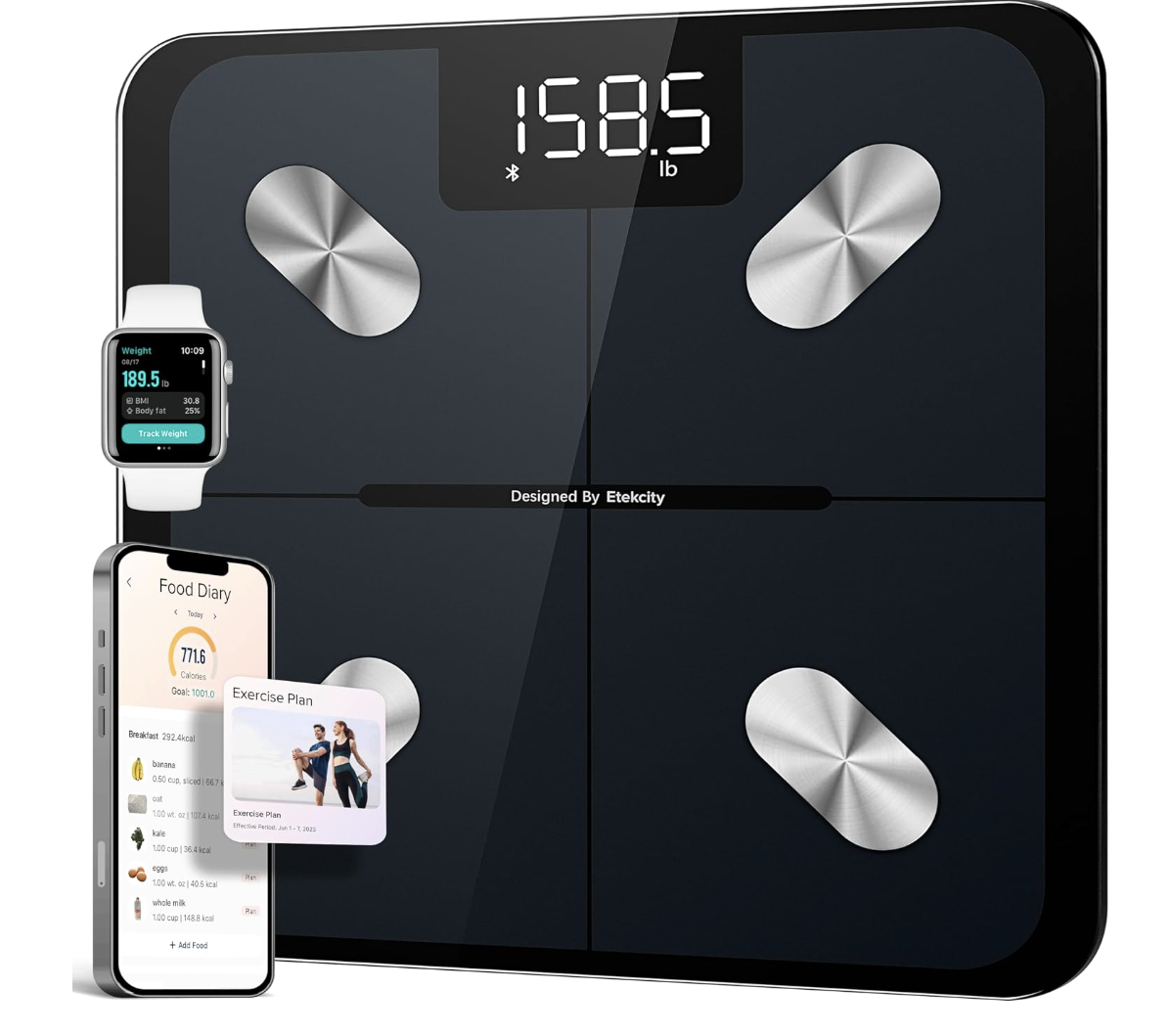
SMART Scale: SALE Price $10

